Slide 1
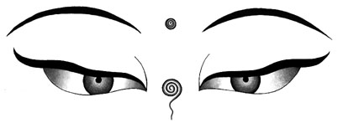
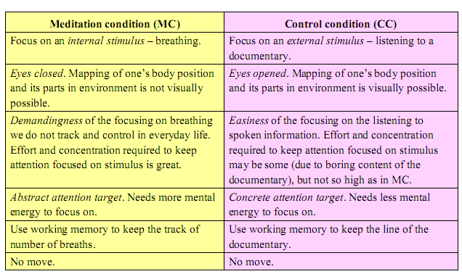
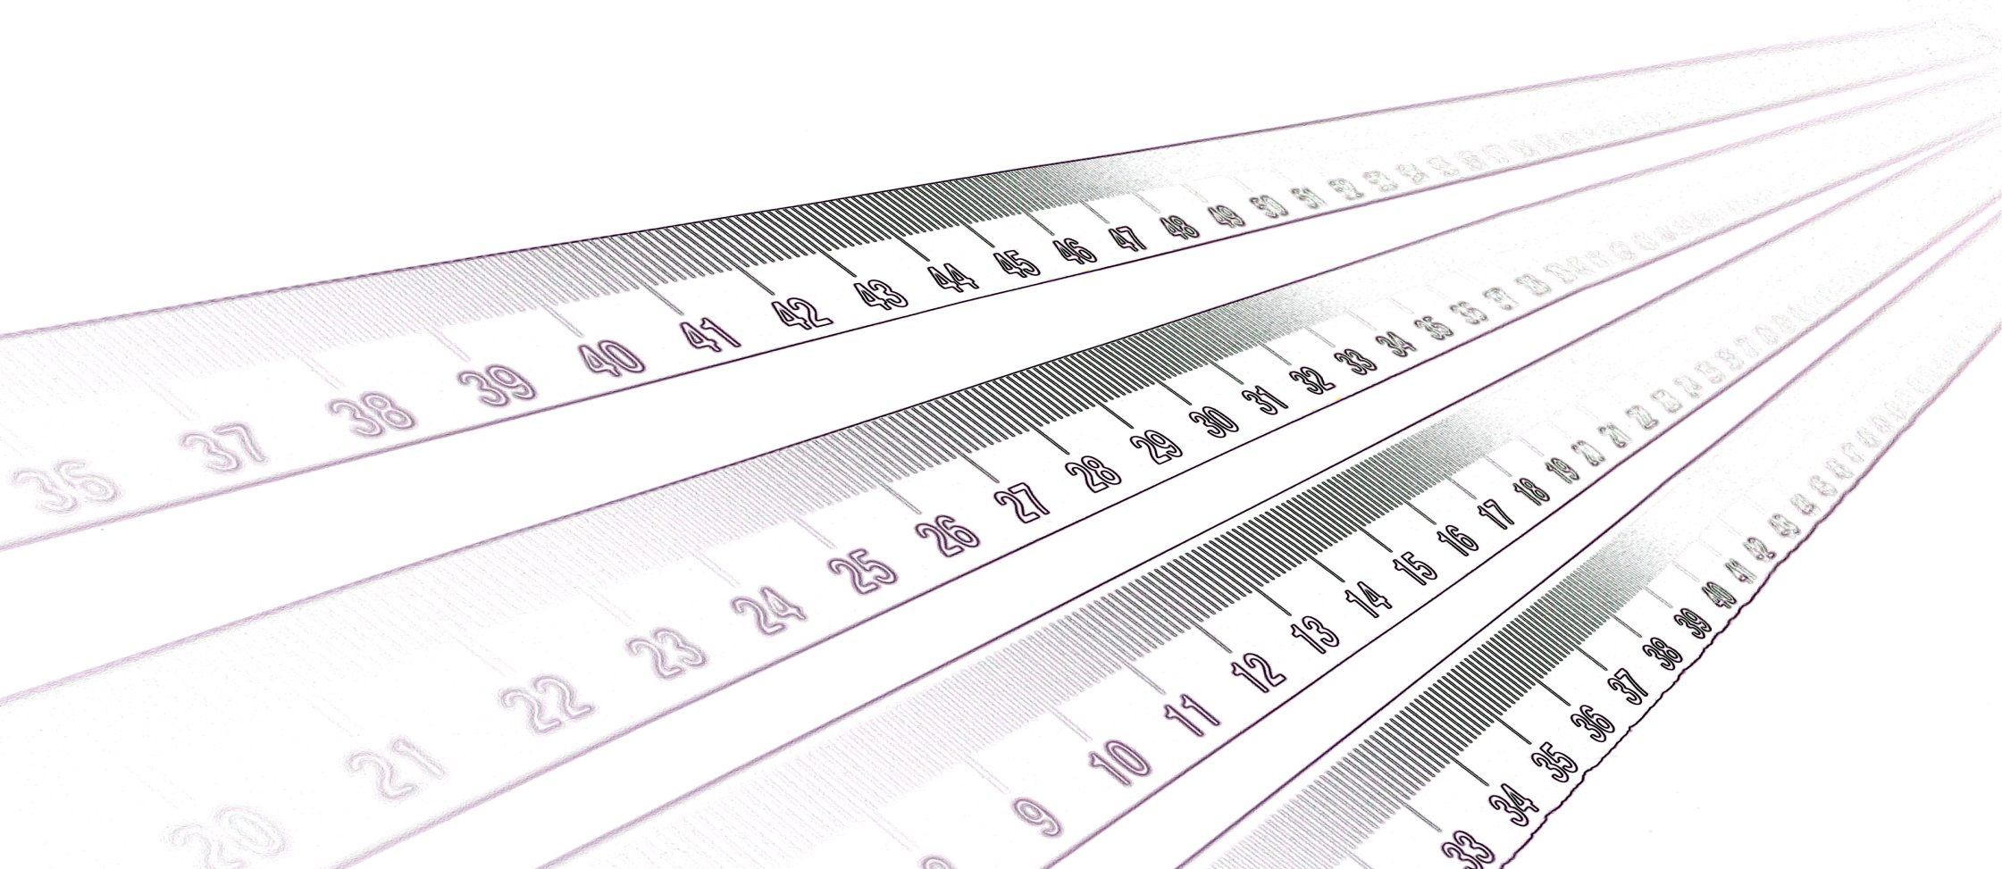
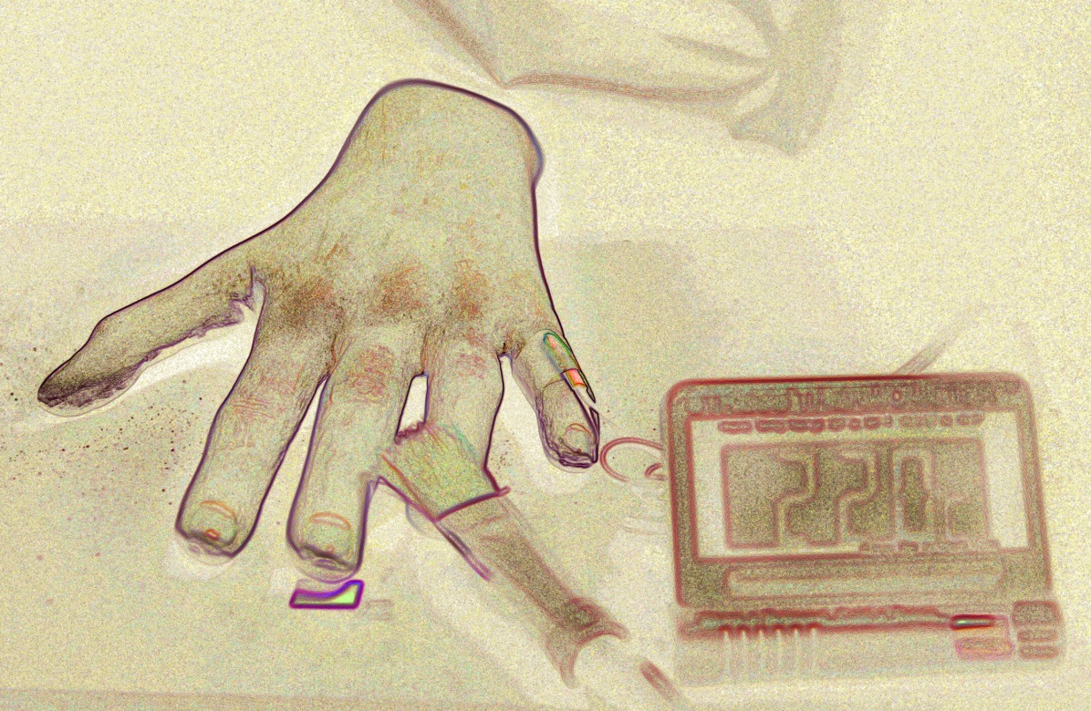
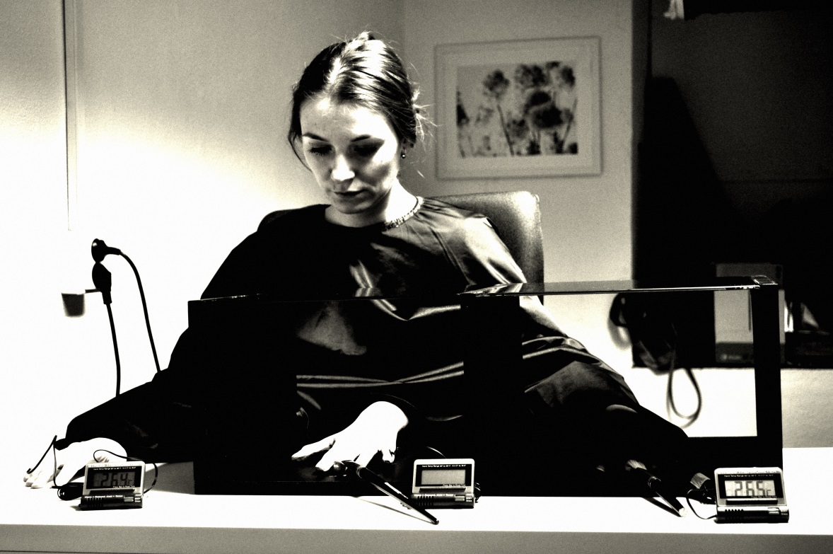
Meditation in the Black B x
Silvie Kotherová Jakub Cigán Paul Reddish
Introduction
Results
Sensations of disappearing body parts, out of body experiences, and near-death experiences have been widely reported in various Buddhist meditation practices. Although, similar experiences have also been reported from everyday life in some individuals (e.g. sleep paralysis). This indicates that the body perception distortions are not specific to cultural practices as meditation. However, our question is: Can cultural practices such as the meditation practice make us to experience these states in a short run?
Self-reported Rubber Hand Illusion: The rubber-hand illusion was successfully induced: 67% participants in the meditation condition and 70% in the control condition responded positively to the question “I felt the touch of the paintbrush in the location where I saw the RH touched”.
A factorial repeated measures ANOVA found no significant Condition x Question interaction: F(8, 448)=.50, p=.86. This suggests that participants experienced the rubber-hand illusion to a similar extent in both conditions.
Proprioceptive Drift: A factorial repeated measures ANOVA found no significant Condition x Time interaction: F(1,56)=2.41, p=.13 and no main effect of Time, F(1,56)=1.23, p=.27. When only those participants who responded positively to the question “I felt the touch of the paintbrush in the location where I saw the RH touched” were examined, there was a significant Condition x Time interaction: F(1,31)=4.24, p=.05. This effect was further strengthened when SSAS was included as a covariate: F(1,30)=6.14, p=.02.
Figure shows how there is drift towards the rubber hand for the Meditation condition, and a drift away from the rubber hand for the Control condition. However, neither of these changes over time were significant: p =.12 (meditation), p=.51 (control).
Temperature Modulation: As predicted, a factorial repeated measures ANOVA found a significant main effect of hand, F(1,55)=4.14, p=.05, with the stimulated hand 0.05°C cooler than the unstimulated hand. However there was no Condition x Hand interaction, F(1,55)=.001, p=.97, suggesting that this effect was similar across conditions.
Unexpected Results: Each 6th participant in the meditation condition felt sick (spinning of head, faintness, disorientation, torpid mind, dizziness). Four participants (extreme sweating, strong feelings of vomiting) were unable to continue the procedure.
Hypothesis
Body perception distortions (proprioception drift) observed in meditation condition (san. Ánápána smrti) will be larger compared to control condition.
Meditation condition: Ánápána smrti, (pál. Anápána sati) meditation practice aimed to breath was operationalized. This meditation practice is based on the closed eyes focused attention to a singular object with an awareness of internal mental processes. This practice has been often connected to the disruption of the practitioners’ body schema.
Control condition: listening to a documentary with open eyes, subject had to be aware of the content and data heard in it - external stimulus.
Participants
60 university students from various departments and faculties.
Not experienced in meditation or yoga practices mainly due to elimination of indoctrination influence.
With no any mental illness (e.g. schizophrenia, epilepsy, depression, or eating disorders etc.) diagnosed.
No regular psychoactive drugs users.
Discussion
No effect of meditation technique on proprioception drift in a short run and in a case of individuals with no experience in meditation and similar practices was observed. The next step: Research on a longitudinal effect of the meditation among experienced Buddhist practitioners.
Participants who experienced RHI scored higher on the Somatosensory Amplification Scale (SSAS). This finding can be connected to the issue of the suggestibility. The next step: Research on the role of a dispositional and situational suggestibility in the meditation.
Experiment pointed our attention to the health problems produced by demanding and intensive mental exercise such as meditation. The next step: Research on well-being and health in connection to intensive meditation practice in non-experienced individuals.
Methods
To induce proprioception drift a standardized method of the rubber hand illusion (RHI) procedure was used. As the proprioception drift measure we used different rulers with shifted number values. A participant had to report number where he feels his middle finger as fast as possible.
Skin temperature measure (STM) of the both stimulated and non-stimulated hands were used to assess relaxed state resulting in increase of skin temperature in each condition. And STM of the both hands as the indicator of proprioception drift during RHI (lower skin temperature has been observed in the stimulated hand) was also used.
RHI standardized questionnaires and open questionnaires for subjective reports, Perceptual aberration scale and Somatosensory Amplification Scale (SSAS) for subject’s predispositions to body schema distortion.
www.levyna.cz

