Slide 1
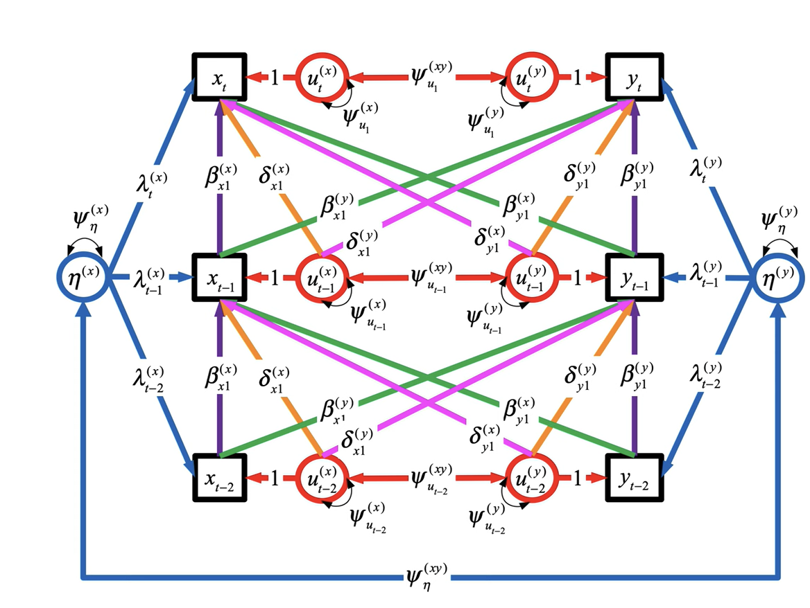
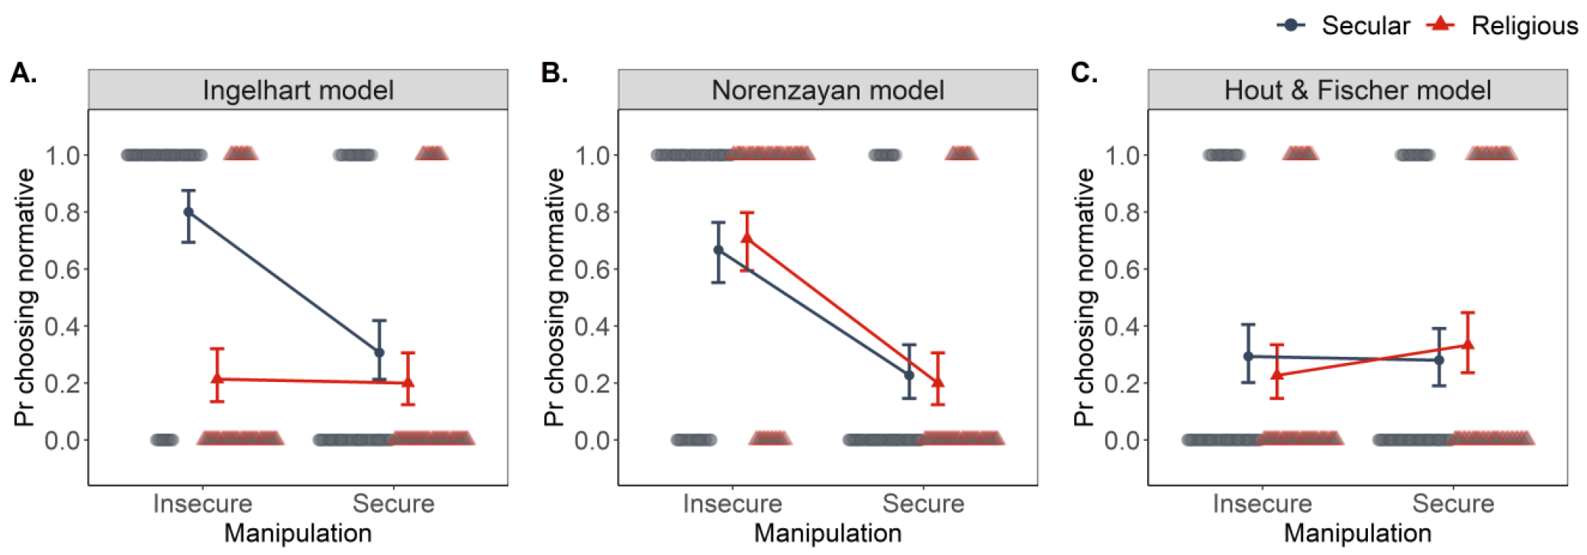
Explaining the rise of non-theism in the US:
The role of material security
Martin Lang
Norris & Inglehart (2011, 2020)
N&I argue that increased existential security reduces the need for religious institutions with costly demands (cognitive dissonance b/w values and desires) BUT
only some aspects of security predict some aspects of religiosity and these effects may be confounded by the demographic dynamic in developing countries
N&I stress the importance of adolescence yet have no developmental data
no test of the cognitive dissonance claim
Is individual decrease in theistic beliefs Granger-caused by material security during childhood? (Study 1)
Is the effect of material security on theistic beliefs facilitated by cognitive dissonance? (Study 2)
Fig.1. DAG for Study 1: Long-term effects
Belief in miracles2
Ritualization2
Religious affiliation
Belief in judgeday2
Gender
Collective ritual2
Belief in God1
Belief in God2
Material security1
Belief in God4
Zyphur, M. et al. (2020)
Fig.2. GCLM for Study 1: Short-term impulses
Study 1
NSYR longitudinal data, ~3,300 US adolescents
4 waves, ages 13-28, parent data in Wave 1
Testing the total and direct effects of parent material security on their children’s belief in god in Wave 4
Testing causal pathways corresponding to aspects of religious systems (Lang & Kundt, 2020) in the long-term (FIG1) and short-term (FIG2)
Study 2
Experimental, 2x2 between-subjects design
800 US and Czech non-theist participants
Random assignment to insecure/secure and religious/secular conditions
Participants choose to play econ. game in normative and norm-free groups (Lang et al., 2022) (FIG3)
Testing whether non-theist forgo cooperative benefits in insecure environments due to clashing relig. values
Parent stress1
Age4
Parent education1
Predictor and outcome variables measured at each Wave
General trust 2-4 ~ Belief in God 2-4
Health 2-4 ~ Belief in God 2-4
Attitudes on sex 2-4 ~ Belief in God 2-4
Parent ritual1
Religious education1
Education4
Fig.3. Simulations of model predictions in Study 2
References
Hout, M., & Fischer, C. (2014). Explaining why more americans have no...
Inglehart, R. F. (2020). Religion’s sudden decline..
Lang et al. (2022). Advertising cooperative phenotype through costly signals...
Lang, M., & Kundt, R. (2020). Evolutionary, cognitive, and contextual approaches...
Norenzayan, A. (2013). Big Gods...
Norris, P., & Inglehart, R. (2011). Sacred and secular..
Zyphur, M. et al. (2020). Building a general cross-lagged panel model (GCLM).

